Slide 1

Week #5
AI Academy®
1
Day 1:
Introduction to Woocommerce
Woocommerce Platform Benefits
Woocommerce Account Creation
Woocommerce Plans & Features
Guidance and support for Account verifications

Slide 2
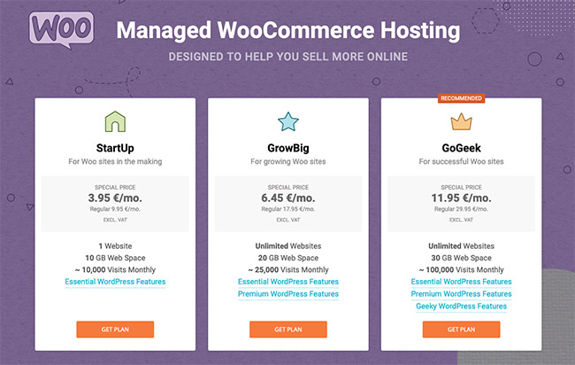
Week #5
AI Academy®
2

Slide 3
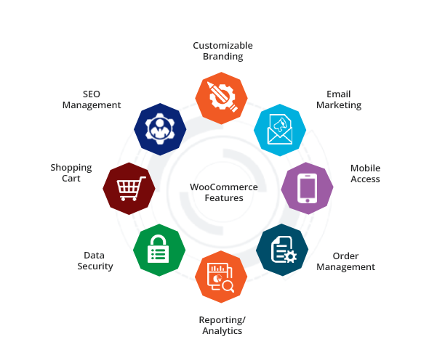
Week #5
AI Academy®
3

Slide 4
Week #5
AI Academy®
4
Day 2:
Introduction to Woocommerce Dashboard
Various Sections and Tools
Order Management
Create Mock Orders
Reviews & Feedbacks

Slide 5
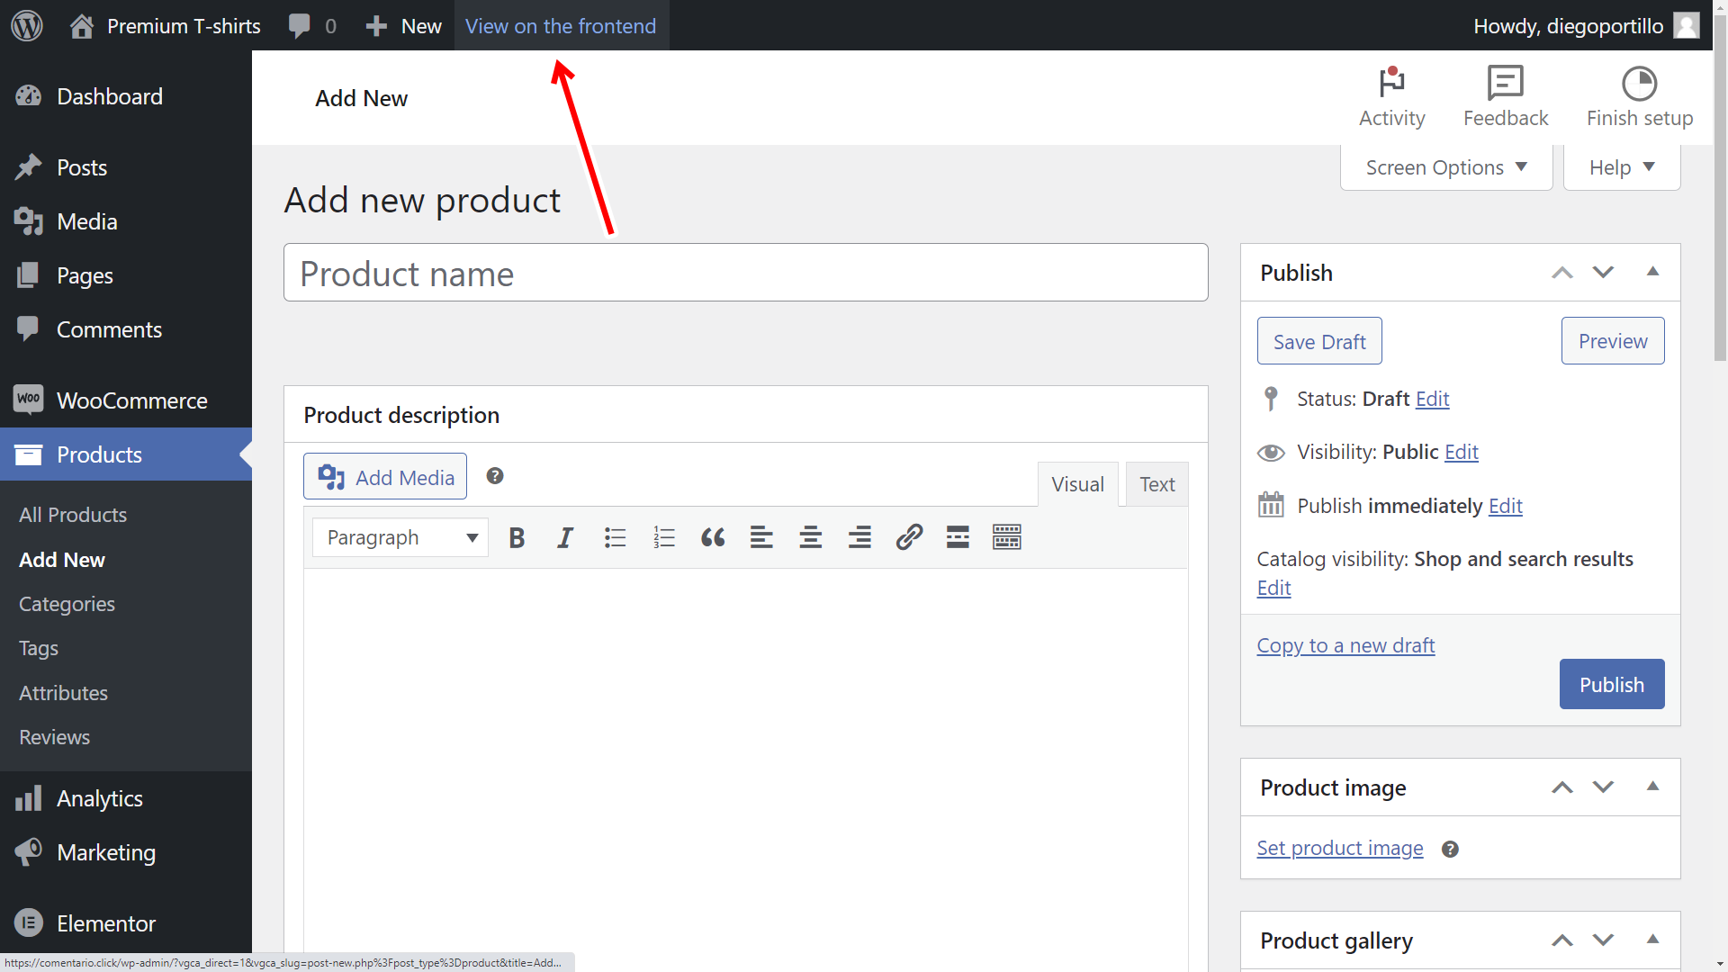
Week #5
AI Academy®
Dashboard Products:
5

Slide 6
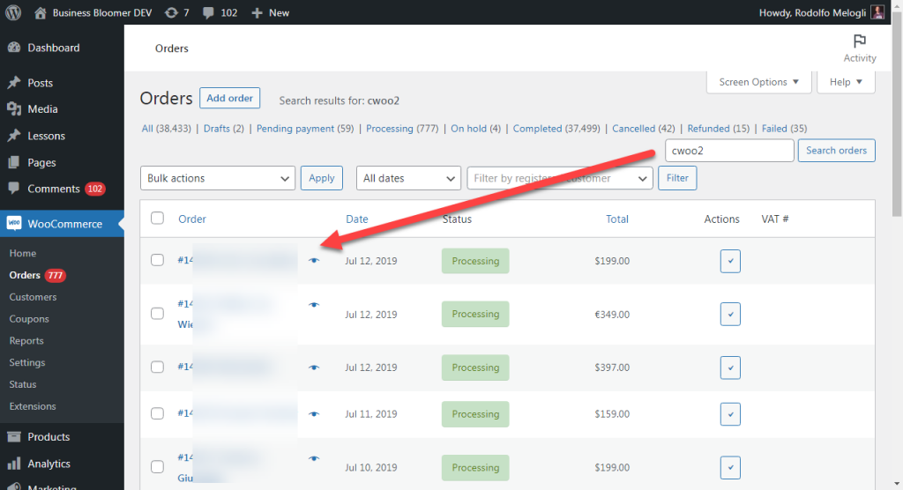
Week #5
AI Academy®
Dashboard Orders:
6

Slide 7
Week #5
AI Academy®
7
Day 3:
Product listing guidelines
Listing requires
Title, Description, Images
Creating Sample Product
Review and Feedback on listing

Slide 8
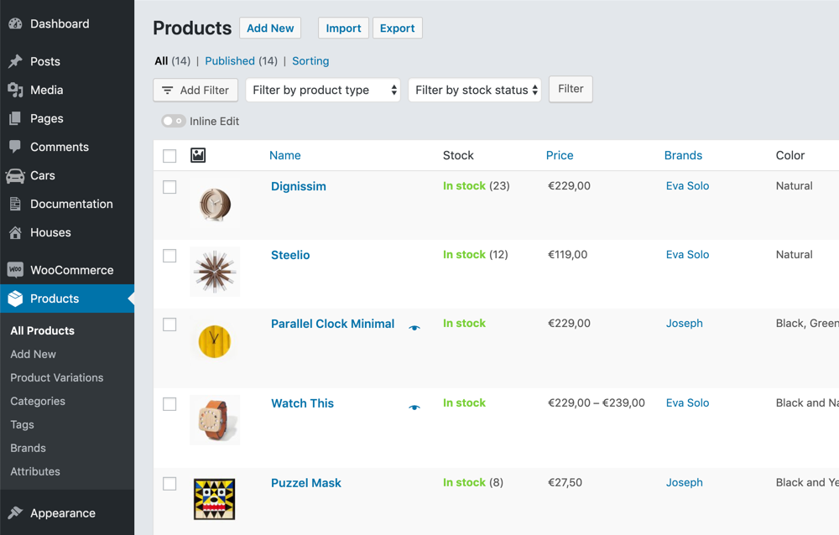
Week #5
AI Academy®
Dashboard Product Listing:
8

Slide 9
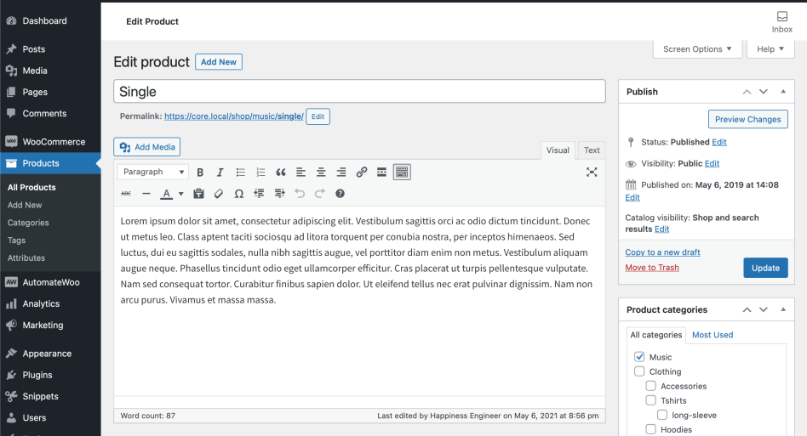
Week #5
AI Academy®
Dashboard Product Listing:
9

Slide 10
Week #5
AI Academy®
10
Day 4:
Explore Woocommerce Store front-end
Guidelines, personalizing
Banners, logos and Brand identity
Troubleshooting and assistance

Slide 11
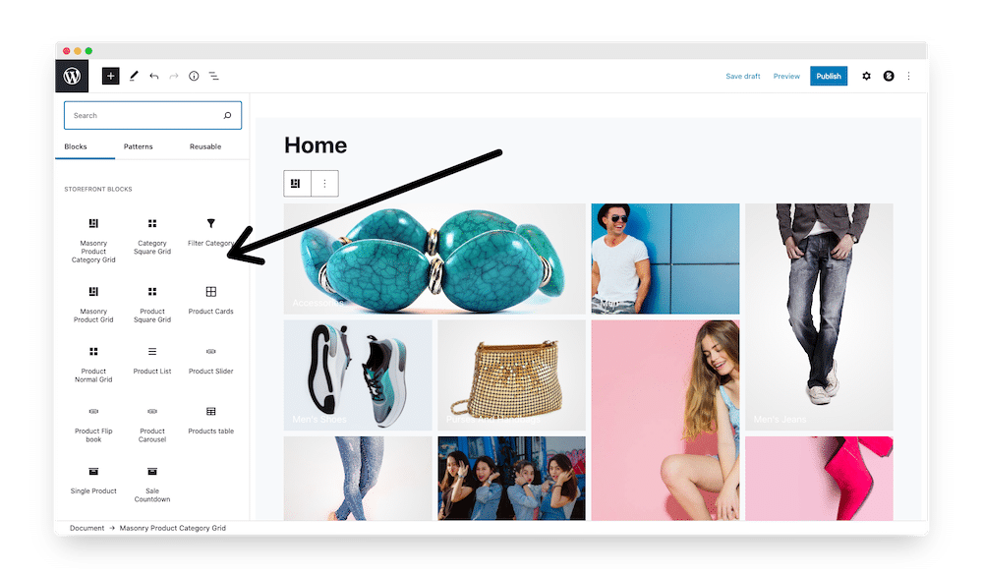
Week #5
AI Academy®
Dashboard Store Frontend Designing:
11

Slide 12
Week #5
AI Academy®
12
Day 5:
Overview Marking tools for Woocommerce Store
Explanation Offers
Promotions, discounts and Sponsoring
Inquiries and managing Orders
Review Inquiries and discussion

Slide 13
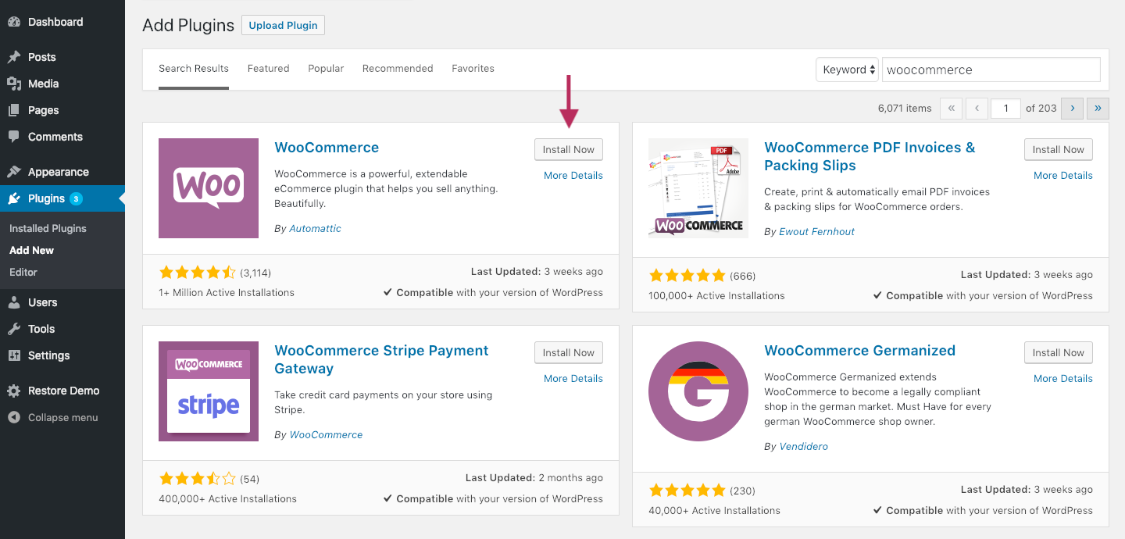
Week #5
AI Academy®
Dashboard Offers and Promotions:
13

Slide 14
Week #5
AI Academy®
Marketing Tools:
14
Omnisend Google, Facebook, Retargeting all-in-one Marketing Kissmetrics Smart Coupons AffiliateWP

Slide 15
Week #5
AI Academy®
Site Building tools:
15
JetWooBuilder SeedProd Elementor YITH WooCommerce Wishlist

Slide 16
Week #5
AI Academy®
Dashboard Checkout, payment and Ship:
16
One Page Checkout Checkout Field Editor Direct Checkout Stripe

Slide 17
Week #5
AI Academy®
Hosting and Security:
17
Hostinger Siteground Dreamhost

